Slide 1
Interaction Design
Angela Sun
DawgBytes 2018
6.25.18

Slide 2
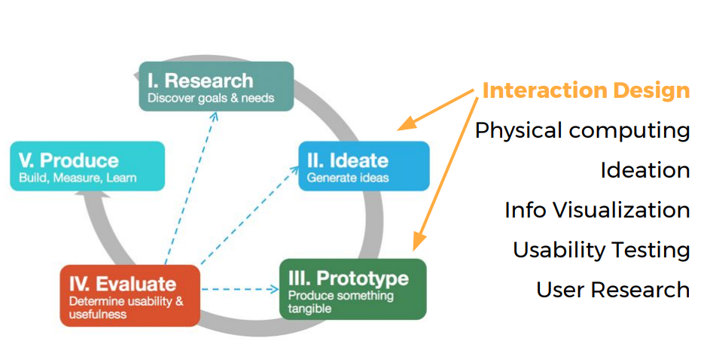

Slide 3
Interaction Design…. (IxD)
Practice of designing interactive environments, digital products, systems, services
Determines HOW users interact with design

Slide 4
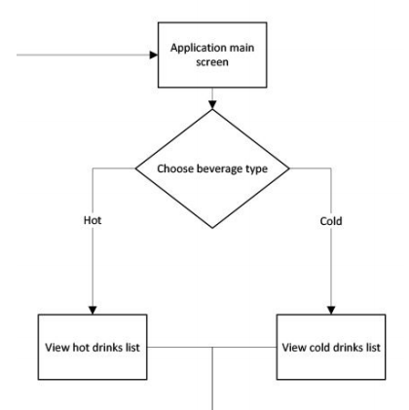
Interaction Flows
Screen: rectangular box
Choice: rhombus box

Slide 5
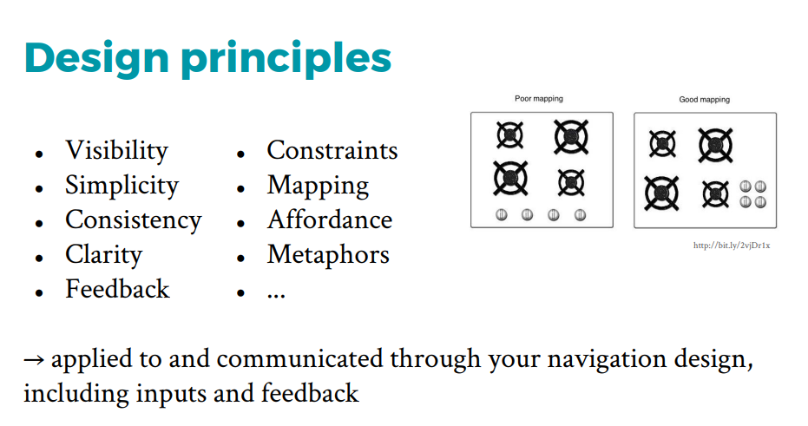
Don Norman, https://medium.com/@sachinrekhi/don-normans-principles-of-interaction-design-51025a2c0f33

Slide 6
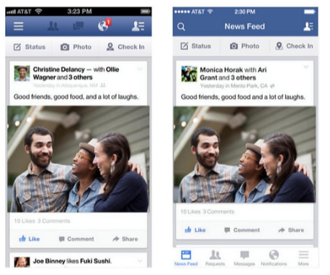
Visibility
Balance between visiblility → ease and cluttered interface
‘Hamburger Menu’ example

Slide 7
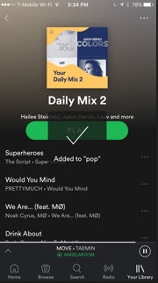
Feedback
Make clear to user what action has been taken

Slide 8
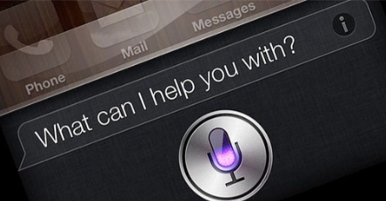
Constraints
Limit range of interaction possibilities → Simplify interface

Slide 9
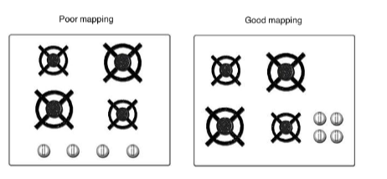
Mapping
Clear relationship between controls and effects

Slide 10
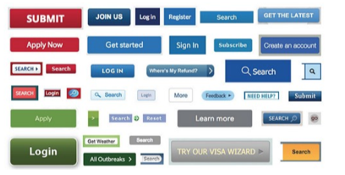
Consistency
Similar operations/elements for similar tasks
Home buttons, back button
Poor Consistency:

Slide 11
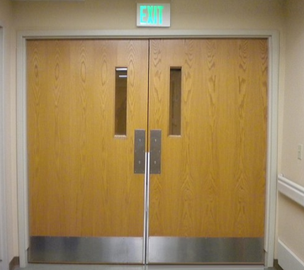
Affordance
Give users a clue of how to use
Door example: push/pull?

